Slide 1
Java Programming

Slide 2
How to create real world entity in Java?
Class Account
{
State
-
-
Behavior
-
-
}

Slide 3
How to create object?
Account a;
a is a used to point an object but still not pointing
a = new Account();
new is an operator
a is a pointer reference to object(memory)
Account is the object
Account a = new Account();

Slide 4
Calling methods using objects
Account a = new Account();
Account a1;
a1=new Account();
a.withdraw();
a1.deposit();

Slide 5
Command line arguments
Arguments which are given along with commands.
A command-line argument is the information that directly follows the program's name on the command line when it is executed.
They are stored as strings in a String array passed to the args parameter of main( ).
So, accessing the command-line arguments inside a Java program is quite easy.

Slide 6
Command line arguments
The command line arguments are given in the following format
C:\> java Test 8.5 “kmit” 10
Test is class name & 8.5 “kmit” 10 are command line arguments
The number of arguments can be calculated using the function length
E.g. args.length
To print arguments we can use a for loop
for(int i=0;i<args.length;i++)
System.out.println(args[i]);

Slide 7
Command Line arguments
Initializing the state of a class using command line arguments.
a.ano=args[0];
a.aholder=args[1];
Type casting in Java: To convert integer to string
Integer.parseInt(args[0]);
Integer is a class, parseInt() will convert integer to string

Slide 8
Data types
There are 2 types of languages:
First, Statically typed language, where each variable and expression type is already known at compile time. Once the variable is declared to be of a certain data type, it cannot hold values of other data types. E.g. C,C++,Java
The other is Dynamically typed languages. These languages can receive different data types over time. E.g. Ruby, Python

Slide 9
Data types
Java is statically typed and also a strongly typed language.
Java is strongly typed language because every variable must be declared with a data type.
A variable cannot start off life without knowing the range of values it can hold, and once it is declared, the data type of the variable cannot change.

Slide 10
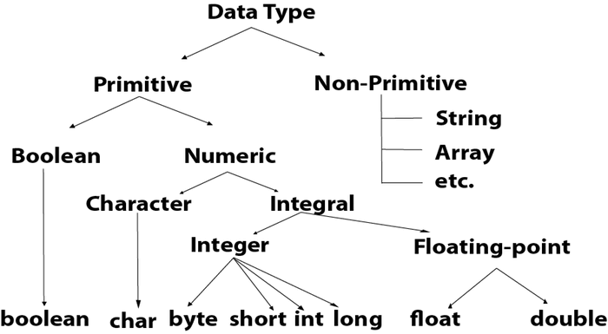
Data type

Slide 11
Data types
There are 8 types of primitive data types: (the size of primitive data types does not change from one operating system to another)
boolean
char
byte
short
int
long
float
double

Slide 12
Data types
byte, short, int and long data types are used for storing whole numbers.
float and double are used for fractional numbers.
char is used for storing characters(letters)
boolean data type is used for variables that holds either true or false.

Slide 13
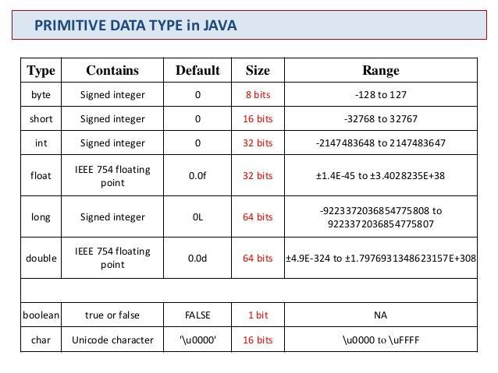

Slide 14
Declarations
Boolean Data type
boolean a = false;
Byte Data type
byte a = 10;
byte b=-20;
Short Data type
short s = 10000;
short r = -5000;
Int Data type
int a = 100000;
int b = -200000;

Slide 15
Declarations
Long Data type
long a = 100000L;
long b = -200000L;
Double Data type
double d = 12.3;
double d = 12E4d;
Float Data type
float f = 234.5f;
float f = 35e3f;
Char Data type
char a = ‘A’;
A floating point can also be a scientific number with an ‘e’ to indicate the power of 10.
Character uses 2 bytes because Java uses Unicode system than ASCII code system. The lowest range of Unicode system is \u0000

Slide 16
Non – Primitive Data types
Non – primitive data types are called reference types because they refer to objects.
E.g. Strings, Arrays, objects, Interfaces, etc.

Slide 17
Difference between Primitive and Non – primitive data types
Primitive Data types | Non – Primitive Data types
They are predefined in Java | They are created by the programmer, not defined by Java (except Strings)
They cannot call methods | They can call methods to perform certain operations
It always has a value | These can be null
It starts with a lowercase letter | It starts with a uppercase letter
Size depends on the data type | All have same size

Slide 18
Java Type casting
Type casting is when you assign a value of one primitive data type to another type.
In Java we have 2 types of casting:
Widening casting (automatically)
Converting a smaller data type to larger type size
Narrowing casting (manually)
Converting a larger type to a smaller size type

Slide 19
Widening
Done automatically when passing a smaller size type to a larger size type.
public class M
{
public static void main(String args[])
{
int i = 9;
double d = i ;
System.out.println(i);
System.out.println(d);
}
}

Slide 20
Narrowing
Must be done manually by placing the type in parenthesis in front of the value
public class M
{
public static void main(String args[])
{
double d = 9.78;
int i = (int)d;
System.out.println(d);
System.out.println(i);
}
}

Slide 21
Variables
The variable is the basic unit of storage in a Java program.
The basic form of a variable declaration:
type identifier [ = value][, identifier [= value] ...];
The type is one of Java‘s atomic types, or the name of a class or interface.
The identifier is the name of the variable.

Slide 22
Scope of the variables
Local variables—in scope from declaration to end of block
Instance variables—in scope from declaration until object garbage collected
Class variables—in scope from declaration until program ends

Slide 23
Operators
Java provides many types of operators that are used to perform operations on variables and values
Types of operators:
Basic Arithmetic operators
Assignment operators
Auto – increment and Auto – decrement operator
Logical operators
Comparison (relational) operators
Bitwise operators
Ternary operator

Slide 24
Basic Arithmetic operators
Basic arithmetic operators are: +, -, *, /, % + is for addition.
– is for subtraction.
* is for multiplication.
/ is for division.
% is for modulo. Note: Modulo operator returns remainder, for example 10 % 5 would return 0

Slide 25
Assignment operators
Assignments operators in java are: =, +=, -=, *=, /=, %= a = b would assign value of variable b to the variable a.
a+=b is equal to a = a+b
a-=b is equal to a = a-b
a*=b is equal to a = a*b
a/=b is equal to a = a/b
a%=b is equal to a = a%b

Slide 26
Auto increment & Auto decrement operators
++ and - - a++ is equivalent to a=a+1;
a- - is equivalent to a=a-1;

Slide 27
Logical operators
Logical Operators are used with binary variables.
They are mainly used in conditional statements and loops for evaluating a condition.
Logical operators in java are: &&, ||, !
Let’s say we have two boolean variables x and y.
x&&y will return true if both x and y are true else it would return false.
x||y will return false if both x and y are false else it would return true.
!x would return the opposite of x, that means it would be true if x is false and it would return false if x is true.

Slide 28
Bitwise operators
There are six bitwise Operators: &, |, ^, ~, <<, >>
x = 11; /* equal to 00001011*/ y = 22; /* equal to 00010110 */
Bitwise operator performs bit by bit processing. x & y compares corresponding bits of x and y and generates 1 if both bits are equal, else it returns 0. In our case it would return: 2 which is 00000010 because in the binary form of x and y only second last bits are matching.
x | y compares corresponding bits of x and y and generates 1 if either bit is 1, else it returns 0. In our case it would return 31 which is 00011111
x ^ y compares corresponding bits of x and y and generates 1 if they are not equal, else it returns 0. In our example it would return 29 which is equivalent to 00011101

Slide 29
Logical (&&, ||) vs Bitwise (&, |)
The logical && operator doesn't check second condition if first condition is false. It checks second condition only if first one is true.
The bitwise & operator always checks both conditions whether first condition is true or false.
The logical || operator doesn't check second condition if first condition is true. It checks second condition only if first one is false.
The bitwise | operator always checks both conditions whether first condition is true or false.

Slide 30
Comparison (Relational) operators
We have six relational operators in Java: ==, !=, >, <, >=, <=
== returns true if both the left side and right side are equal
!= returns true if left side is not equal to the right side of operator.
> returns true if left side is greater than right.
< returns true if left side is less than right side.
>= returns true if left side is greater than or equal to right side.
<= returns true if left side is less than or equal to right side.

Slide 31
Bitwise operators
~x is a complement operator that just changes the bit from 0 to 1 and 1 to 0. In our example it would return -12 which is signed 8 bit equivalent to 11110100
x << 2 is left shift operator that moves the bits to the left, discards the far left bit, and assigns the rightmost bit a value of 0. In our case output is 44 which is equivalent to 00101100
Note: In the example below we are providing 2 at the right side of this shift operator that is the reason bits are moving two places to the left side. We can change this number and bits would be moved by the number of bits specified on the right side of the operator. Same applies to the right side operator.
x >> 2 is right shift operator that moves the bits to the right, discards the far right bit, and assigns the leftmost bit a value of 0. In our case output is 2 which is equivalent to 00000010

Slide 32
Ternary operator
This operator evaluates a boolean expression and assign the value based on the result. Syntax:
variable h = (expression) ? value if true : value if false
If the expression results true then the first value before the colon (:) is assigned to the variable h else the second value is assigned to the h.

Slide 33
Expressions
An expression is a formula in which operands are linked to each other by the use of operators to compute a value. An operand can be a function reference, a variable, an array element or a constant.

Slide 34
Operator precedence in Java
This determines which operator needs to be evaluated first if an expression has more than one operator. Operator with higher precedence at the top and lower precedence at the bottom. Unary Operators ++ – – ! ~
Multiplicative * / %
Additive + –
Shift << >> >>>
Relational > >= < <=
Equality == !=
Bitwise AND &
Bitwise XOR ^
Bitwise OR |
Logical AND &&
Logical OR ||
Ternary ?:
Assignment = += -= *= /= %= > >= < <= &= ^= |=

